Slide 1
Software Engineering Lecture # 6

Slide 2

Outline
2
SDLC Models
Sequential Model
▫ Waterfall Model
▫ V-Model

Slide 3

SDLC Models
3
Sequential model
  Waterfall model.
  V-model
Incremental model
  Incremental model.
  Spiral model
  RAD (Rapid application development) model

Slide 4

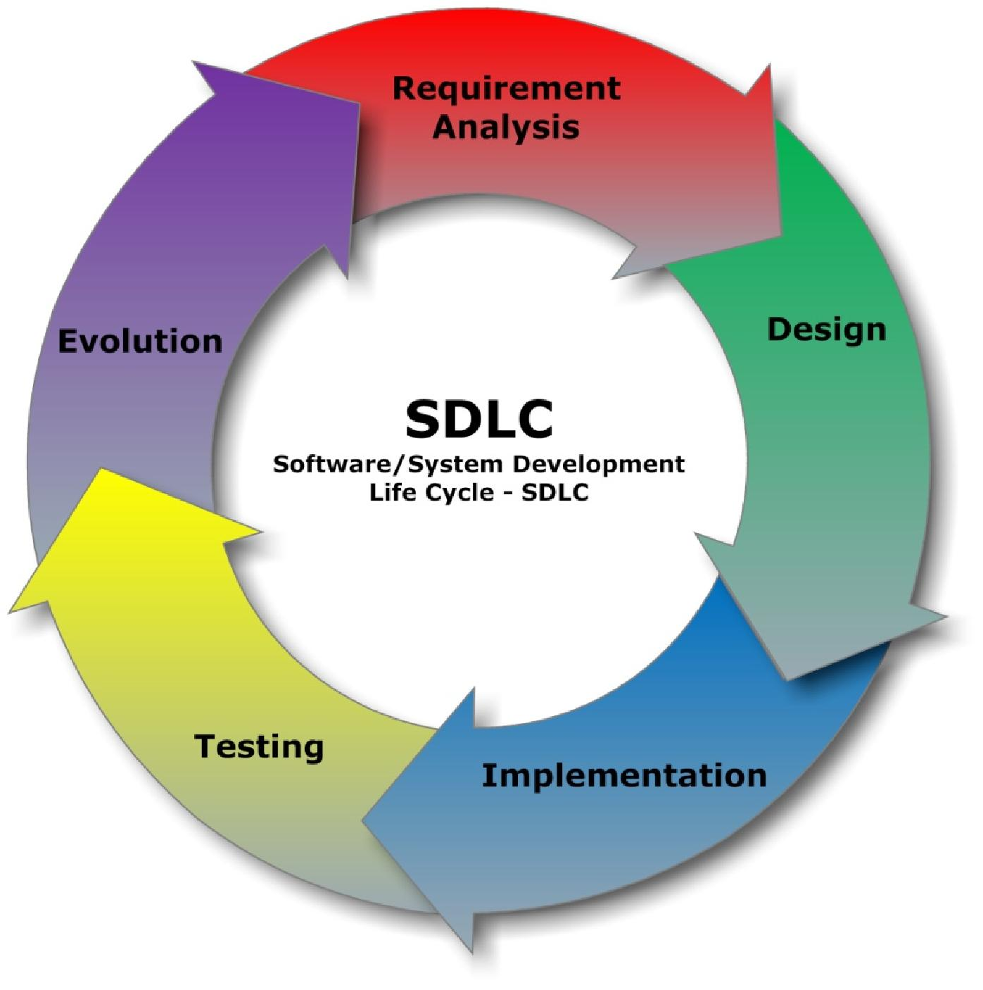
Waterfall Model
4

Slide 5

History of waterfall
5
In 1970 Royce proposed what is now popularly referred to as the waterfall model as an initial concept.
It has been widely used for software projects ever since.
Afterwards he explored how the initial model could be developed with feedback from each phase influencing previous phases.

Slide 6

Waterfall Model
6
Sequential software development model
▫ development is seen as flowing steadily downward through several phases.
Each phase must be completed fully before the next phase can begin.
Document Driven
At the end of each phase, a review takes place to determine if the project is on the right path.

Slide 7

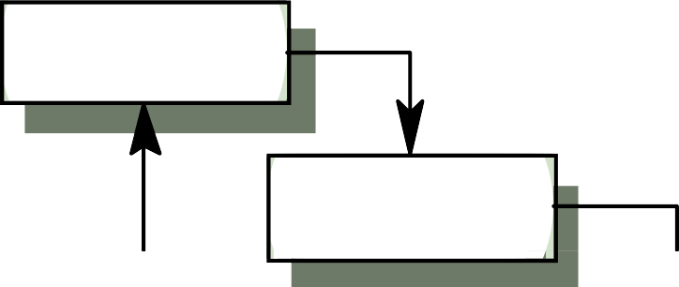



Waterfall Model
7
Requirements definition
System and software design
Implementation and unit testing
Integration and system testing
Operation and maintenance

Slide 8

Waterfall Model
8
In theory:
▫ Each phase produces documents that are:
  Verified.
  Assumed to be complete.
▫ Each phase depends on the documents of the previous stage to proceed → it has to wait for the completion of previous stage.
In practice:
▫ The phases overlap and feedback to each other (see the feedback arrow in the diagram).

Slide 9

Where to use the waterfall model
9
Requirements are very well known, clear and fixed.
Product definition is stable.
Technology is understood.
There are no ambiguous requirements
New version of an existing product
Porting an existing product to a new platform.

Slide 10

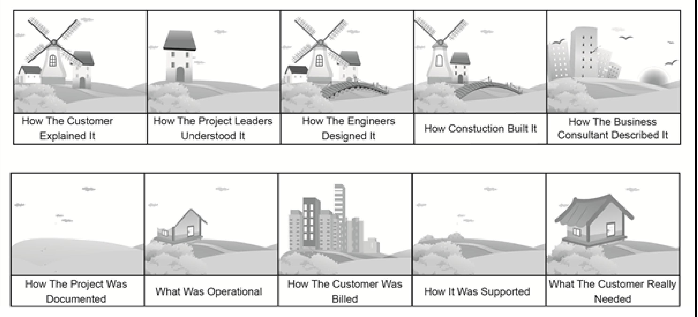
Challenges with Waterfall Model
10

Slide 11

Advantages of Waterfall
12
Easy to understand, easy to use
Sets requirements stability
Milestones are well understood
Works well when quality is more important than cost or schedule
▫ Phases are processed and completed one at a time.
No phase is complete until the Tangible products (the various documents) are done and checked by SQA team.

Slide 12

Disadvantage of Waterfall
13
All requirements must be known upfront
Not Flexible- if requirement change it may not work
Difficult to estimate time and cost for each stage of the development process.
High amount of risk and uncertainty.
Constant testing of the design is needed.
Can produce excessive documentation
Few signs of progress until the end

Slide 13

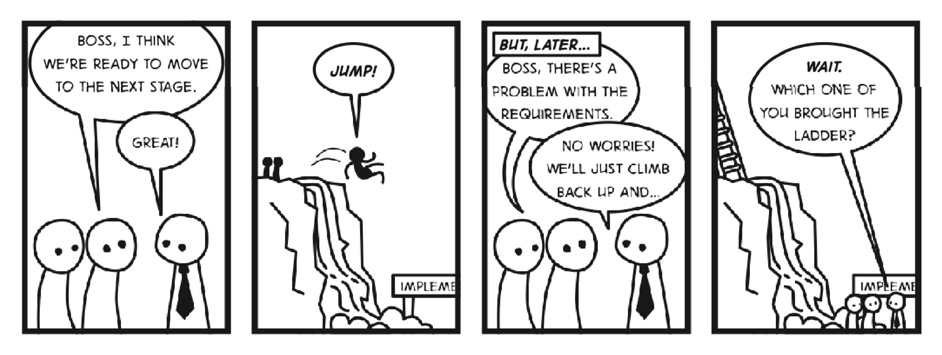
Waterfall Model
14

Slide 14


V-Shaped SDLC Model
15

Slide 15

V-Shaped SDLC Model
16
V- model means Verification and Validation model.
Variant of Waterfall model
Emphasizes verification and validation of the product
Just like the waterfall model, the V-Shaped life cycle is a sequential path of execution of processes.
Each phase must be completed before the next phase begins.
Testing of the product is planned in parallel with a corresponding phase of development

Slide 16

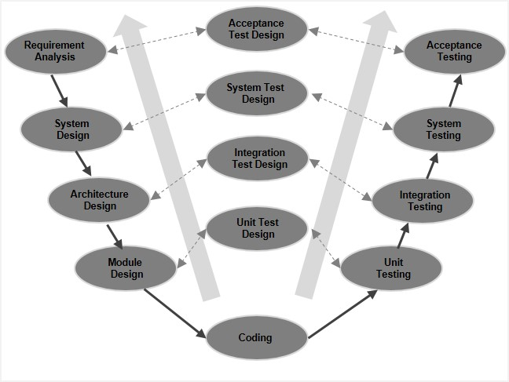
V-Shaped SDLC Model
17

Slide 17

V-Shaped Strengths
18
Higher chance of success over the waterfall model
Simple and easy to use.
Testing activities like planning, test designing happens well before coding.
Proactive defect tracking – that is defects are found at early stage.
Works well for small projects where requirements are easily understood.

Slide 18

V-Shaped Weaknesses
19
No dynamic changes in requirements
No risk analysis activities
Very rigid, like the waterfall model.
No early prototypes of the software are produced.
If any changes happen in midway, then the test documents along with requirement documents has to be updated.

Slide 19

Problem Scenario
20
We received a requirement specification from a client for developing a solution for their specified problem in a domain we have little or no expertise and obviously no experience of developing similar solution.

Slide 20

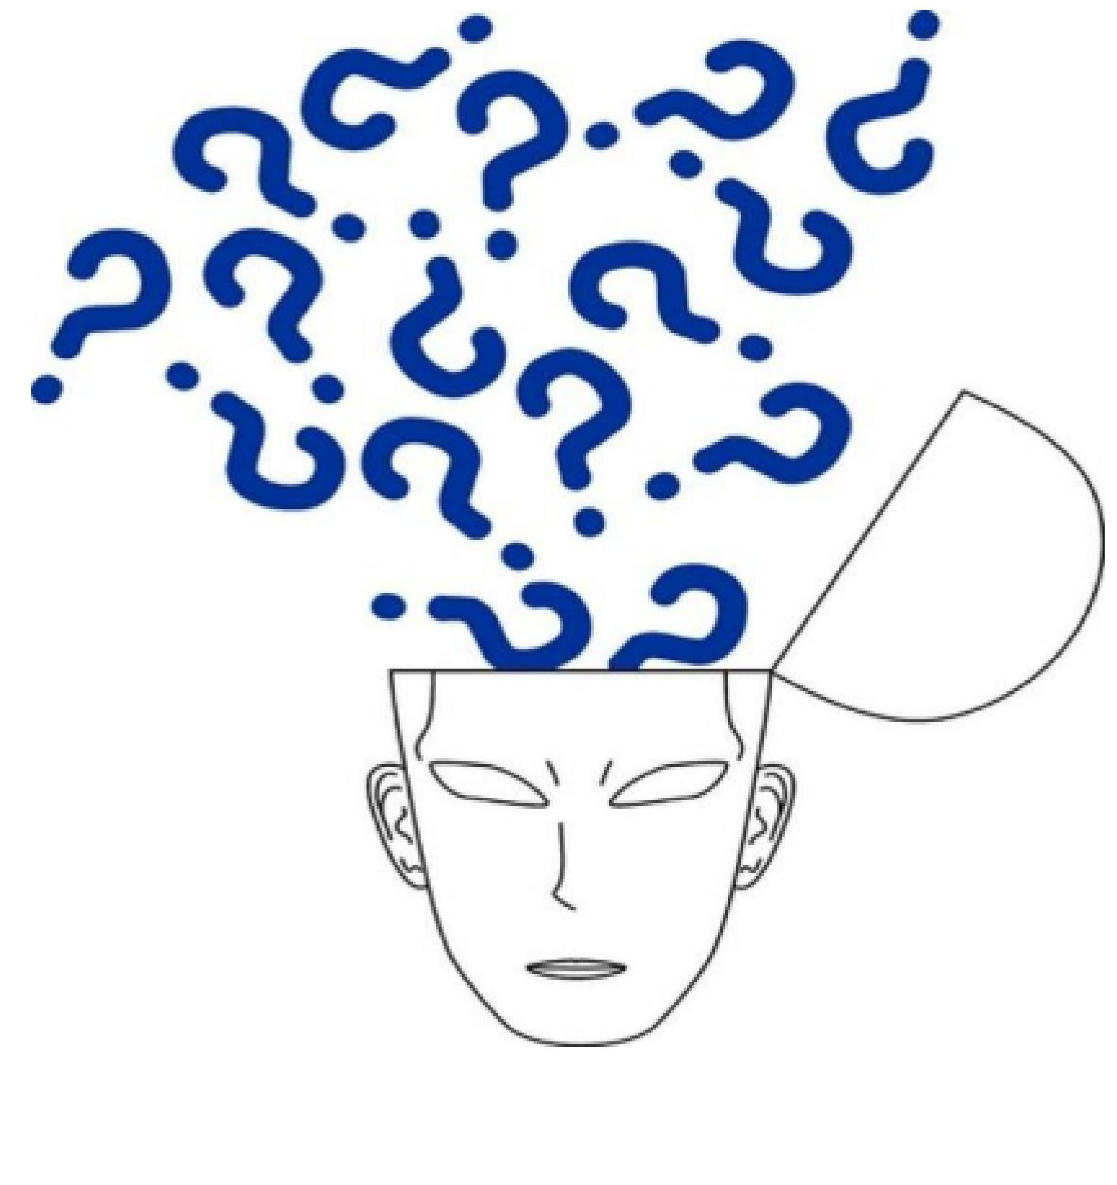
Questions?
21

